Slide 1
After-Testing Feedback
NoiseFiltering

Slide 2
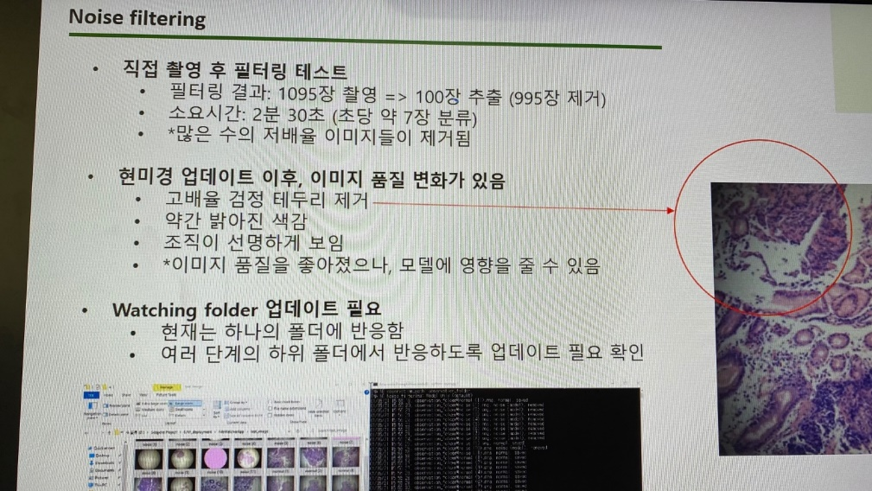
Feedback
After testing the filtering directly
Filtering result: 1095 images => 100 photos were stored (removed 995)
Time used: 2 minutes 30 seconds (approximatedly 7 images per second)
*large number of low-scale images removed
After update the microscope, image quality changes
Remove high scale black surround
Brightness of image: brighter
The image are clearly visible
*image quality was improved; it might effect the model
Need of watching folder update
Now: only ONE folder can be observed
Need: Watcher should be able to observe subfolders in multiple levels

Slide 3
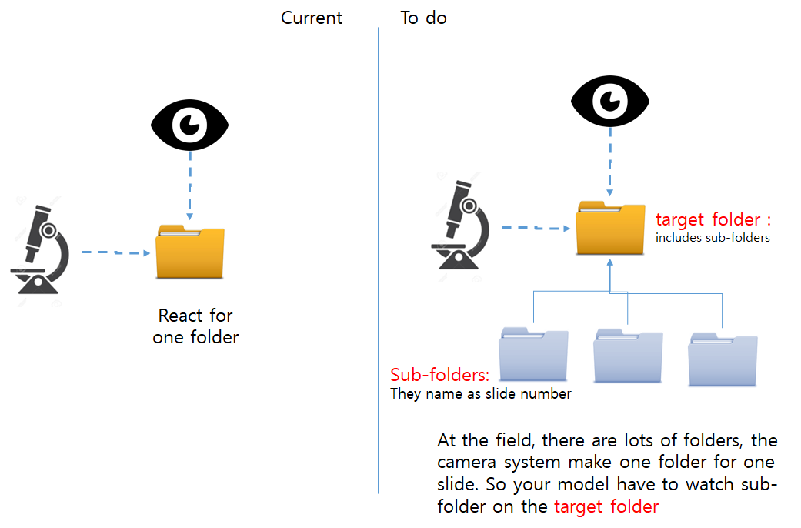

Need of watching folder update
Need: Watcher should be able to observe subfolders in multiple levels
observation_folder
test1
test2
sub1-1
sub2-1
sub2-2

Slide 4
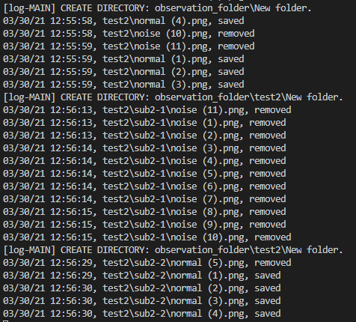
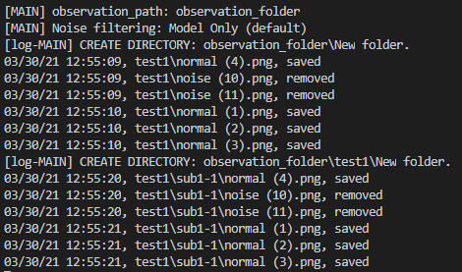
Need of watching folder update (2)
observation_folder
test1
test2
sub1-1
sub2-1
sub2-2

Slide 5
Issues found
Folder name, file name, file path must be in LATIN alphabet.
Operating folders and subfolders one-by-one is FINE; however, operating them as a bundle can cause the file-lost and run-time issues.
observation_folder
observation_folder
1
3
test1
test2
test1
test2
2
4
5
sub1-1
sub2-1
sub2-2
sub1-1
sub2-1
sub2-2

Slide 6
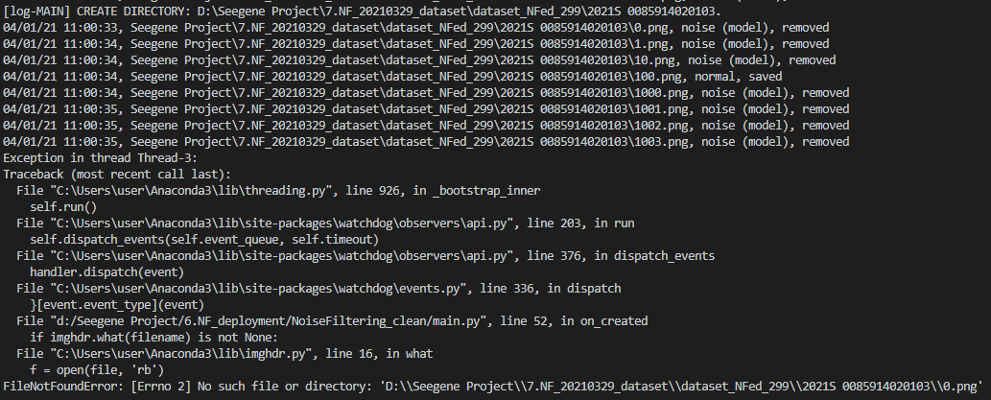
Issues found
file-lost and run-time issues

Slide 7
Make It Faster (3)
Goal: 10 images/sec
Now: ~7 images/sec

Slide 8
MobileNets
Deep CNN for mobile application from Google, 2017. (https://arxiv.org/abs/1704.04861)
Less complexed, less memory used, faster, can be computed real-time in small device.
Trade-off: accuracy is lower than resnet50 (https://arxiv.org/pdf/1810.00736)

Slide 9
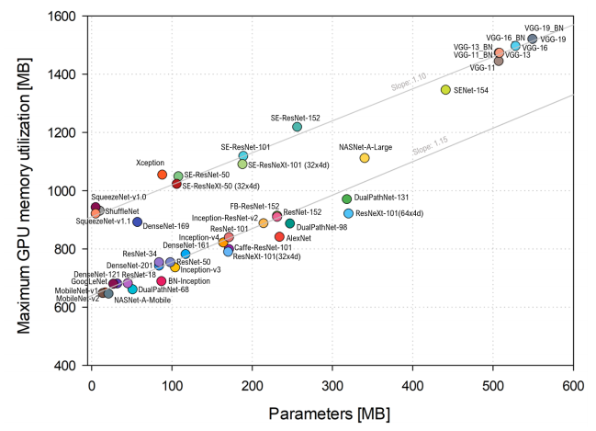
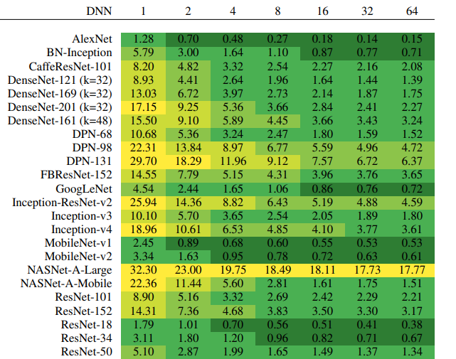
MobileNets (2)
Inference time (ms) vs. batch size.
Inference time per image is estimated across different batch sizes for the Titan Xp.
Plot of the initial static allocation of the model parameters (i.e. the model complexity) and the total memory utilization with batch size 1 on the Titan Xp.

Slide 10
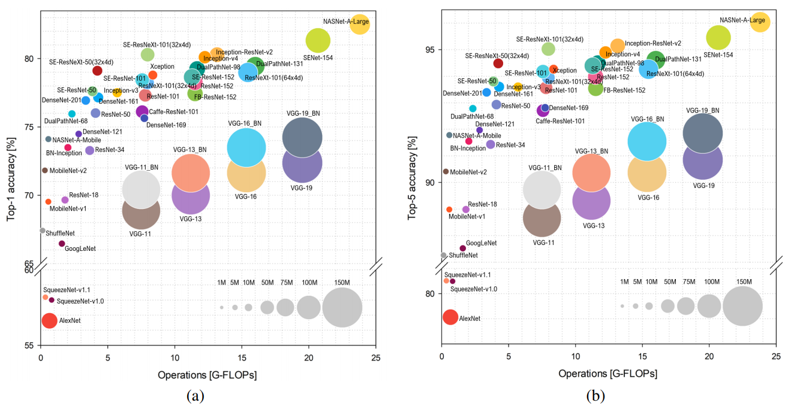
MobileNets (2)
Ball chart reporting the Top-1 and Top-5 accuracy vs. computational complexity. Top-1 and Top-5 accuracy using only the center crop versus floating-point operations (FLOPs) required for a single forward pass are reported. The size of each ball corresponds to the model complexity. (a) Top-1; (b) Top-5.

Slide 11
To do
Figure out file-lost and runtime issue
Build MobileNets and compare its performance with resnet50
Update manual

Slide 12
Thank you
🌸 JJ 🌸

